Slide 1


Slide 2
introduction
Machine learning (ML) is the scientific study of algorithms and statistical models that computer systems use in order to perform a specific task effectively without using explicit instructions, relying on patterns . It predicts and forecasts the future.
Python is a general purpose interpreted interactive object oriented and high level programming language. It places strong emphasis on code reliability and simplicity so that the programmers can develop applications rapidly.

Slide 3
About project
The Health Insurance Prediction System is designed by using supervised regression algorithms to predict the premium covered in particular insurance plan so that he needn’t go to the insurance company or insurance agent.
The charges are estimated based on gender, children, bmi and age as inputs.

Slide 4
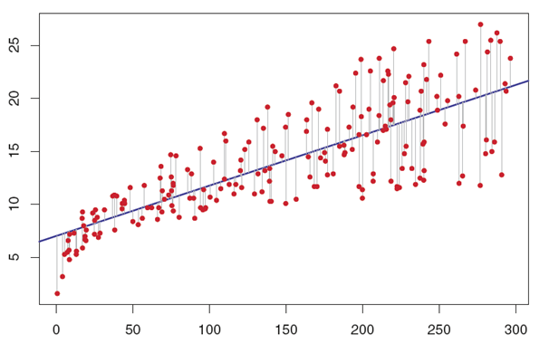
Model explanation
Regression is an approach to model the relationship between a dependent response variable and one or more explanatory variables.
A regression model is therefore useful in predicting what is likely to happen in the next time period, or even in the far future.

Slide 5
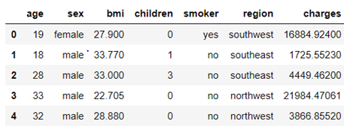
Dataset explanation
https://www.kaggle.com/bmarco/health-insurance-data

Slide 6
Model-decision tree regression
Model built using Decision Tree:
STEP 1: Importing Decision Tree Regressor package.
STEP 2: Predicting values and fitting model by using x_train and y_train parameters.
STEP 3 : Finding accuracy.

Slide 7
conclusion
The aim of this research is to propose and implement a rule based system to predict the charges from the collection of past data. This has been achieved by Decision Tree Regression algorithm on previous dataset.

